Slide 1
Bank Marketing Classification
Using Machine Learning
Course: Pattern Recognition
Instructor: Dr. Yasmine
Team: Moustafa, Yousef, Ahmed Masry, Mohamed, Ahmed Salah
Date: 1/5/2026

Slide 2
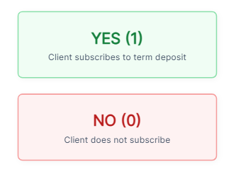
Problem Statement
The goal is to predict whether a client
Will subscribe to a term deposit
based on their profile and marketing
campaign data.
This is formulated as a Binary
Classification Problem.

Slide 3
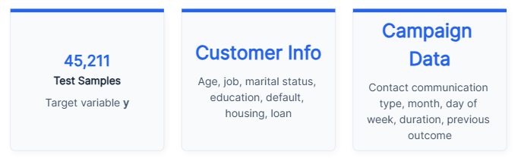
Dataset Overview
Using the Bank Marketing Dataset to train and evaluate models.

Slide 4
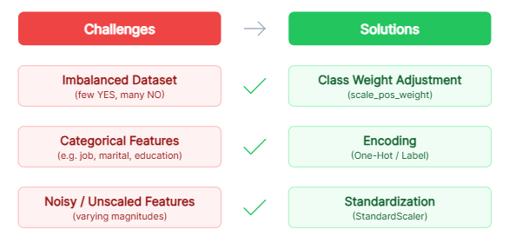
Challenges & Solutions

Slide 5
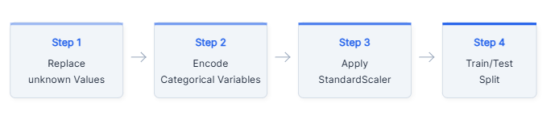
Preprocessing Pipeline

Slide 6
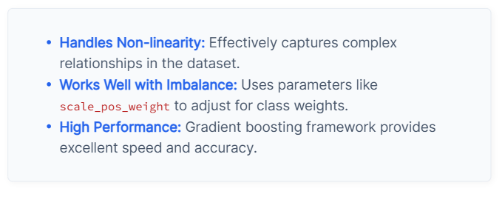
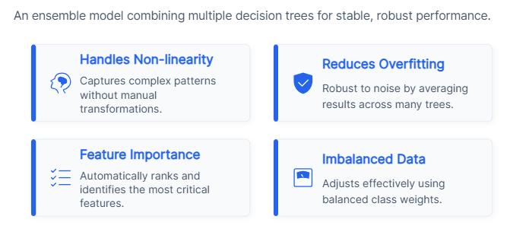
Model Used: XGBoost
Random Forest Model

Slide 7
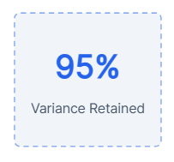
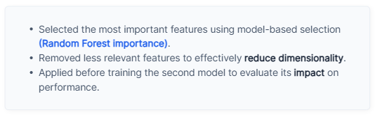
Dimensionality Reduction
PCA (Principal Component Analysis)
Reduced dimensions while keeping 95% variance of
the data.
Applied before training the second model to evaluate
its impact.
Feature Selection

Slide 8
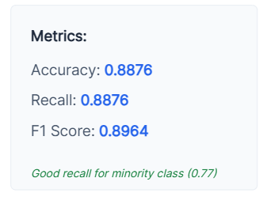
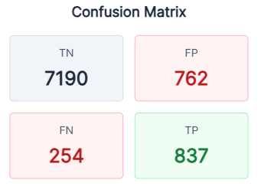
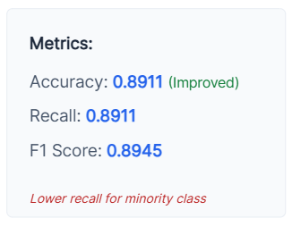
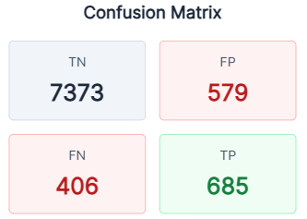
Results: XGBoost (Original)
Results: PCA + XGBoost

Slide 9
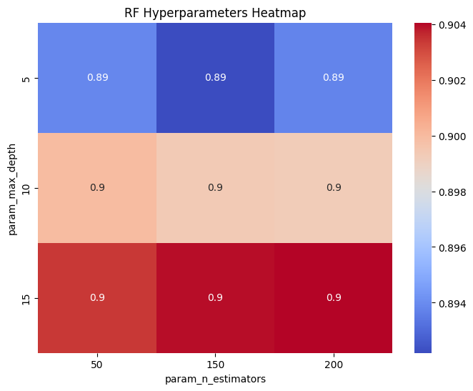
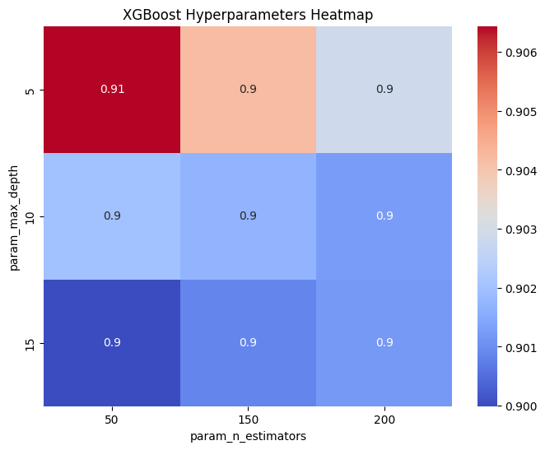
Used GridSearchCV to optimize model parameters.
Tuned parameters:
• n_estimators
• max_depth
Applied on:
• Random Forest
• XGBoost
What the Heatmap shows:
• Best parameter combination
• Performance differences across values
Hyperparameter Tuning

Slide 10
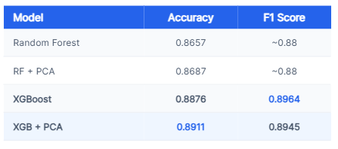
Final Comparison

Slide 11
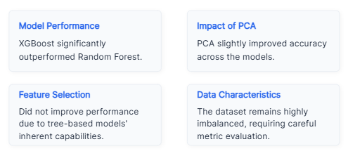
Key Findings

Slide 12
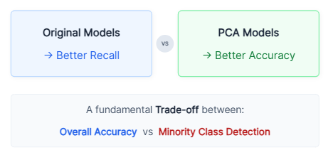
Model Trade-off

Slide 13
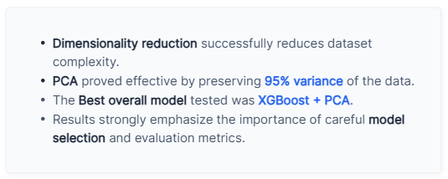
Conclusion

